Slide 1

Closing Remarks on the HIV RTCQI Workshop in South Africa
June 7, 2024
RTCQI Best Practice Workshop – Africa Region, Cape Town

Slide 2



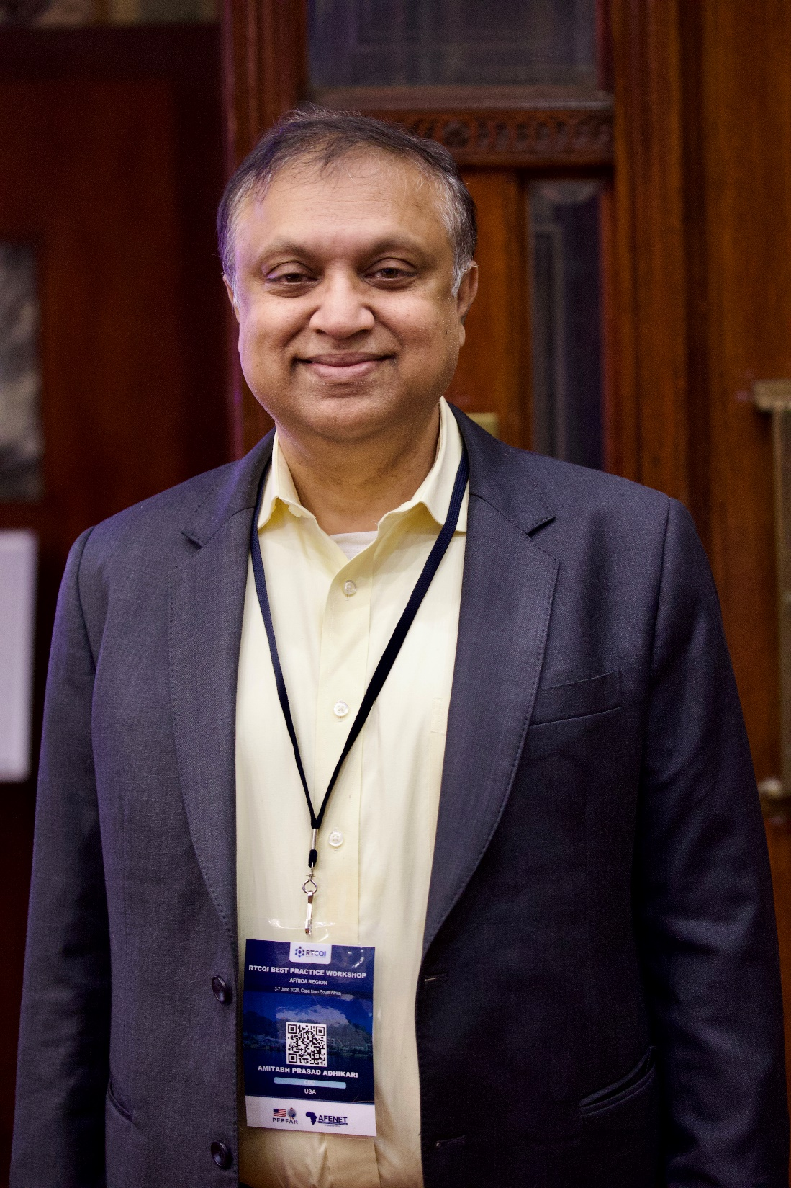







Appreciation of Workshop Planners, Logisticians etc.

Slide 3

Audio Visual Team, Registration etc.

Slide 4

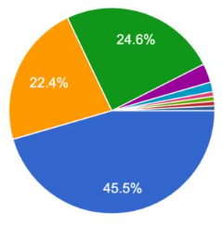
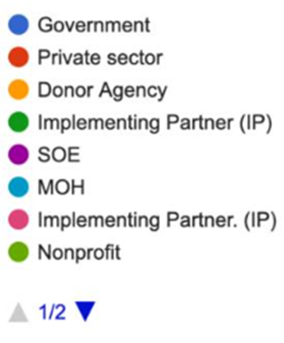
Participants
Presence of PEPFAR, IP and MOH

Slide 5
Critical Steps to Ensure Accuracy of Testing
Having a policy around HIV testing that mandates who, when why
Selecting right tests and testing algorithm
Adequate training of testers including certificate and recertification
Standard record keeping/logbook
Proficiency testing program
Robust supply chain and inventory management system
Kit lot verification at national or regional level
Active and ongoing corrective action program

Slide 6
Key Enablers & Critical Steps of Successful HIV Quality Testing
Ensure strong CQI processes, including the incorporation of HIV RT-CQI, for all countries, regardless of the testing algorithm being used.
Encourage all countries implementing either algorithm to conduct retesting for verification before commencing ART. Retesting for verification will significantly improve the PPV even with the 2-test algorithm.
Encourage strong post market surveillance for all testing approaches
Encourage strong collaboration between all stakeholders is vital. This is the integration of science, politics and policy in the delivery of health care

Slide 7

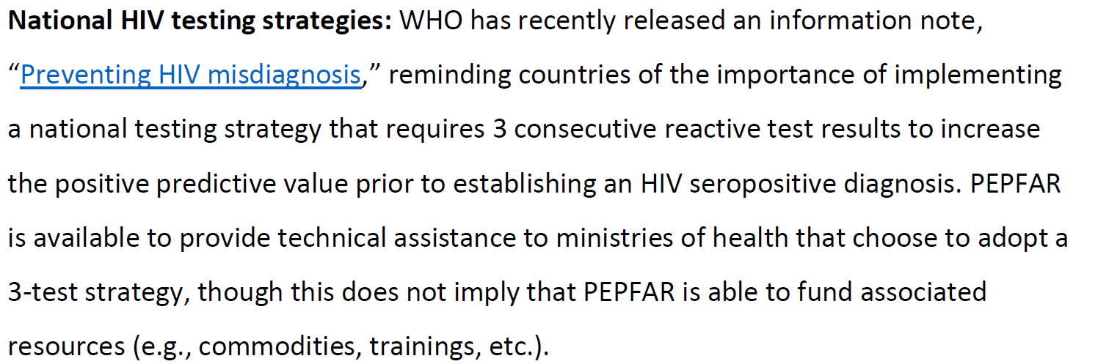
HIV Testing Strategies | Quality of Testing is More Critical than Just Testing Strategy

Slide 9

Performance of National Algorithm in Nigeria-

Slide 10
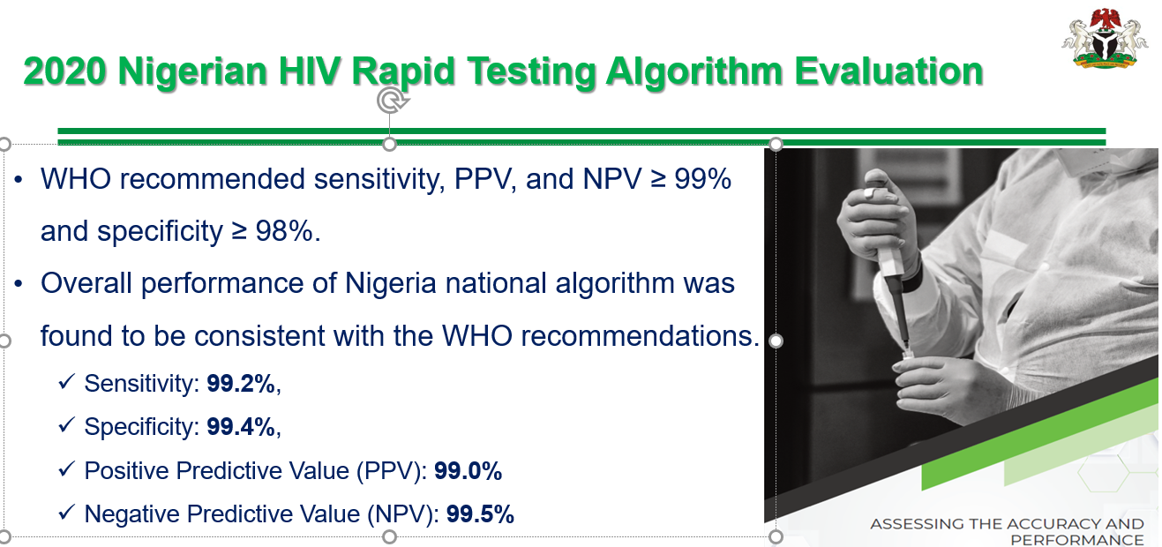
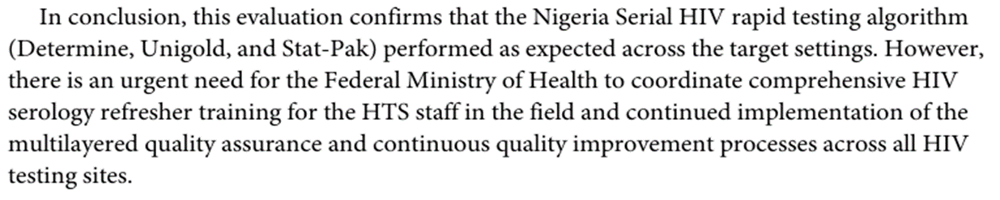
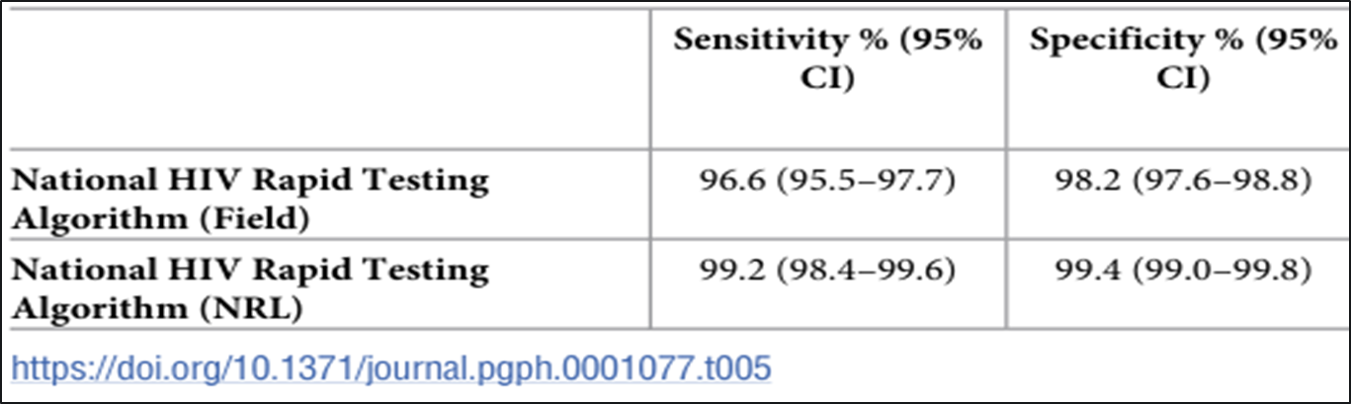
Data to Inform on the Performance of the Algorithm

Slide 11
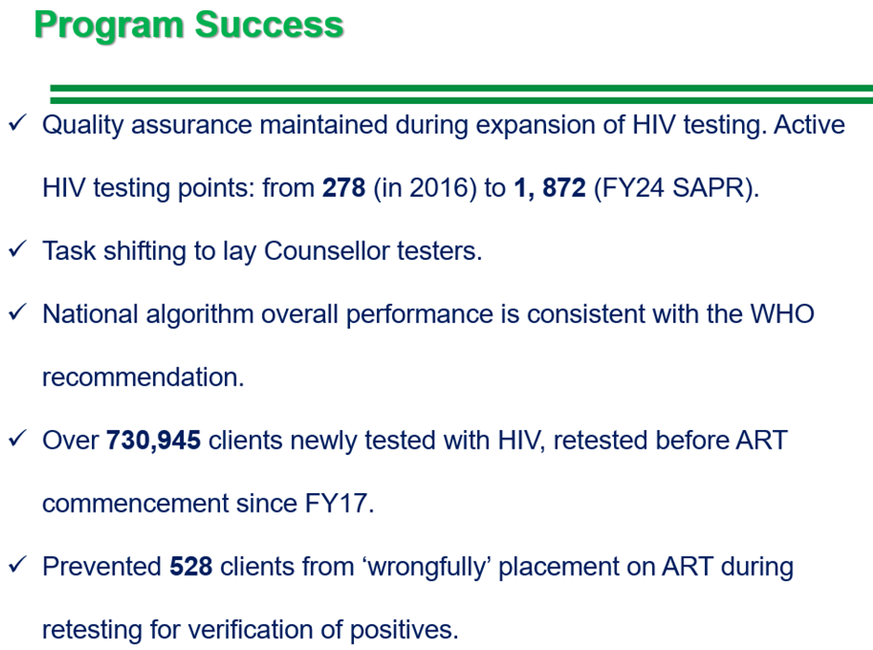

Slide 12
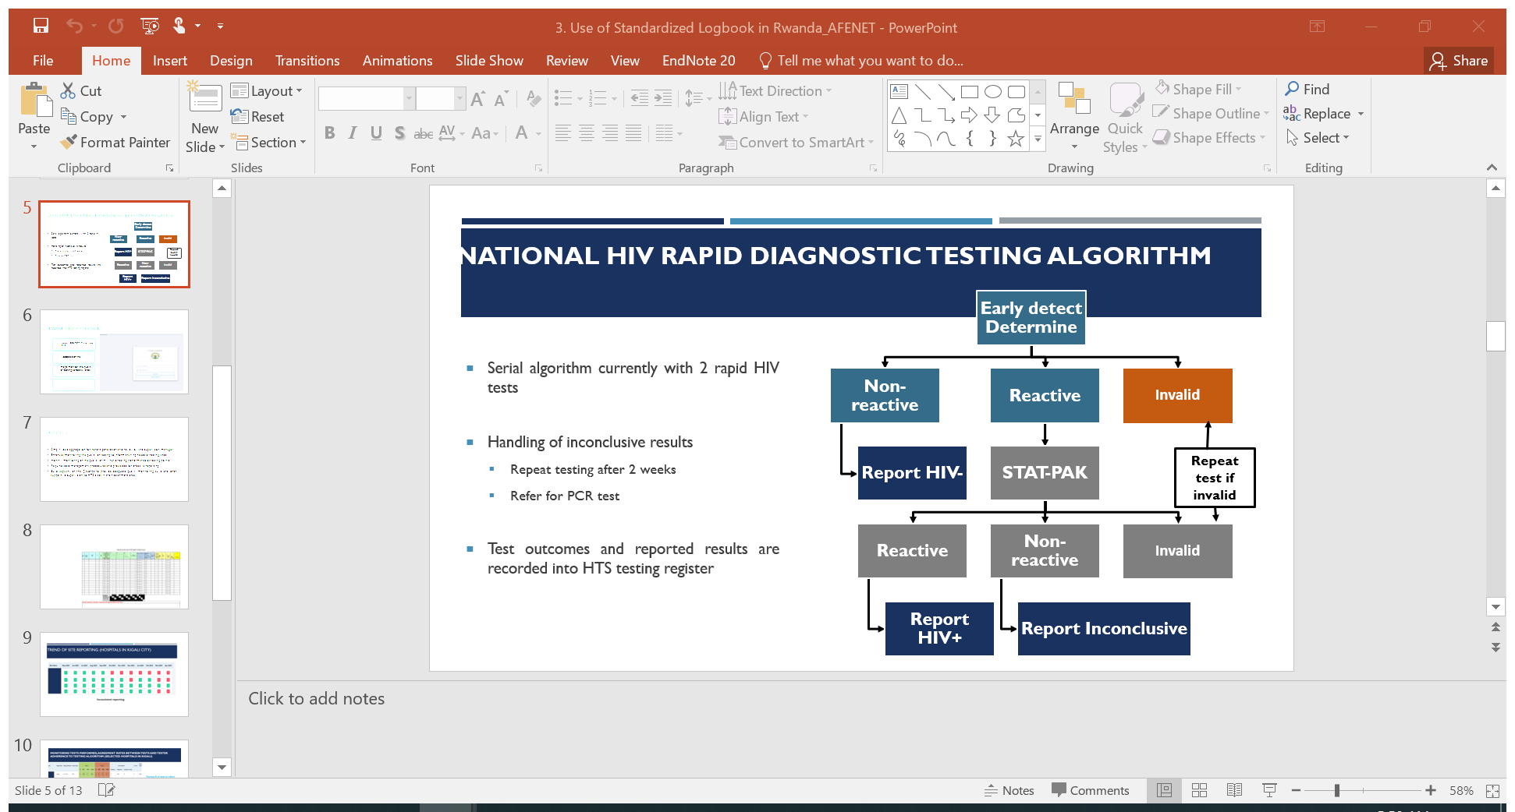
Using Data to Inform on Performance of 4th Gen Tests
Think of PT etc.

Slide 13

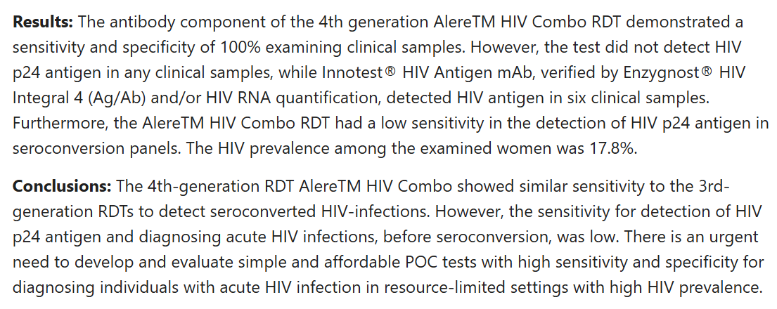
Performance of the 4th Generation Rapid Tests

Slide 14


Slide 15
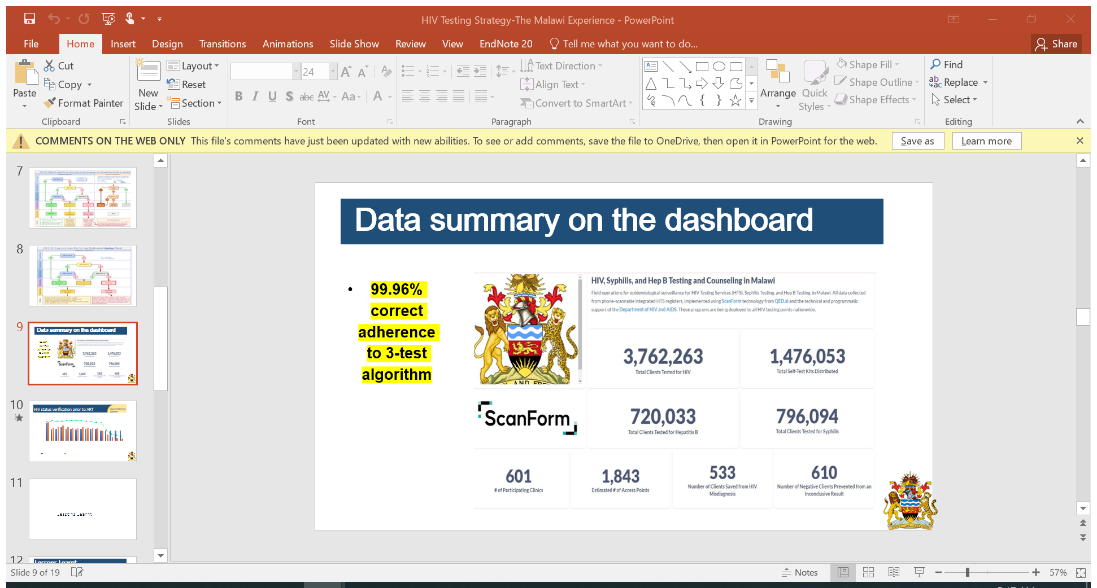
Using Data to Inform on Performance of 3-Test Algorithm

Slide 16
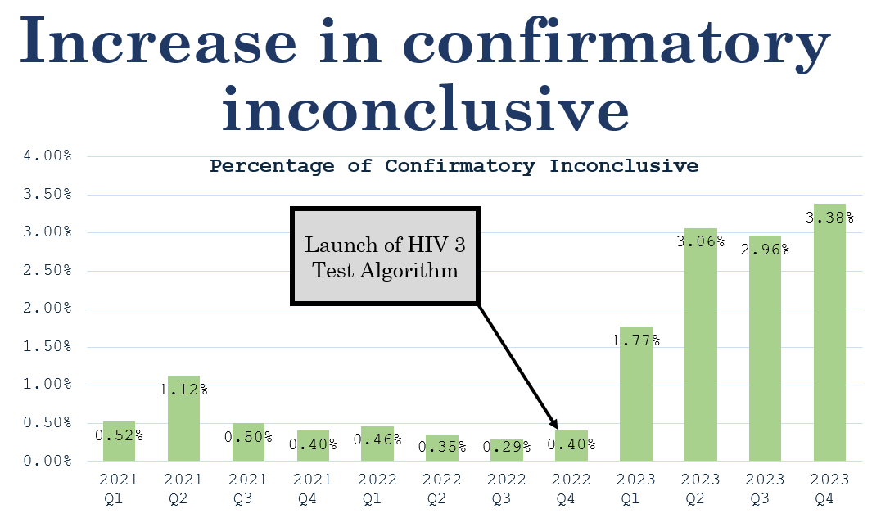
Increase in Number of Inconclusives Following Switch

Slide 17
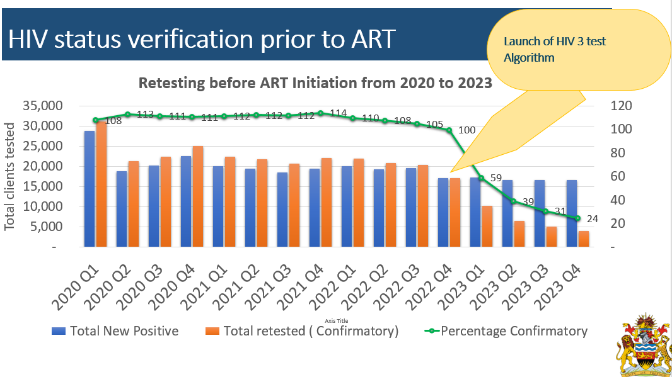
Drop in Retesting for Verification Prior to ART-Malawi

Slide 18

Encourage Sharing Lessons Learnt
Of the 4 countries that have switched from 2-3 tests testing algorithm, share lessons learnt so other countries can emulate
Issues around cost of 3rd test
Issues around the number of inconclusives
Issues around the number of finger pricks
Etc.

Slide 19
Issues Raised and Complains Shared by Countries
Lack of coordination at country levels on discussions relating to algorithm switch
WHO and MOH should ensure involvement of all stakeholders
Stakeholders should work together at country and HQ levels for practical guidance
Lack of commodities to support algorithm switch evaluations
WHO needs to clarify
WHO data on 3 tests limited to two countries, and not consistent with country claims, for example, Malawi not doing retesting for verification, though WHO claims so.
Interruption in testing when 1 test in the algorithm is not available
Issues on procurement
Alternative algorithm

Slide 20
Issues Raised and Complains Shared by Countries
Performance of some tests in retesting-clients on ART retesting
Stability of PT samples using DTS

Slide 21
Outstanding Issues
Not able to compare 2 and 3 tests testing algorithms
Lack of standardization
Retesting for verification is not done by all within the same country
Some testing not utilizing QA modules such as RTCQI
Not using trained testers
Hence, there is need for standardization before comparison of these testing strategies
Guidance on the use of 4th Generation tests
Specific support that can be offered by WHO on the transition from 2-3 testing algorithm with retesting for verification-countries want to know

Slide 22
Gaps, Challenges and Opportunities-

Slide 23
Some Outcomes
South-to-South collaboration
The Triple alliance: gov’t, IP and PEPFAR
Publications- reach out if you need our assistance
Community of practice
Sharing of tools
Presentations from the workshop
Best practices
Annual RTCQI Summary report to track progress and advocate for resources
Workshop report
We came here to learn and to share best practices

Slide 24
“Anyone who stops learning is old, whether at twenty or eighty. Anyone who keeps learning stays young”
Henry Ford

Slide 25

UBUNTU
“We are all in this together”
There is no single factor that can contribute to quality results, as there is no single individual that will contribute to quality results!
Thank You!

Slide 26
Henry Ford, who is well known to some of you, “Anyone who stops learning is old, whether at twenty or eighty. Anyone who keeps learning stays young.

